Slide 1
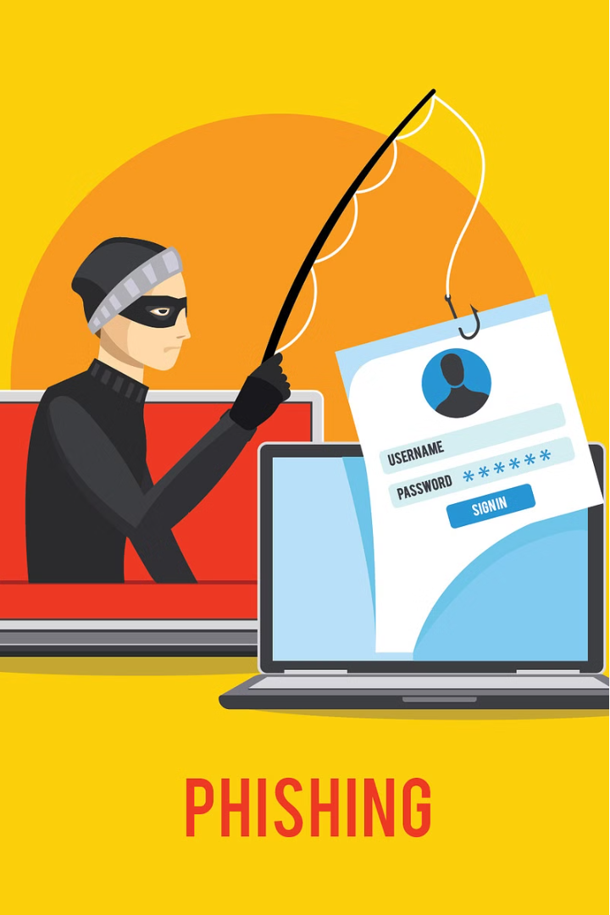

Introduction to Phishing Attacks
Phishing is a malicious technique where attackers try to trick individuals into revealing sensitive information, such as login credentials or financial data. This presentation will educate you on the tactics used by phishers and how to protect yourself from falling victim to these scams.
by SEERA SUNIL YADAV

Slide 2
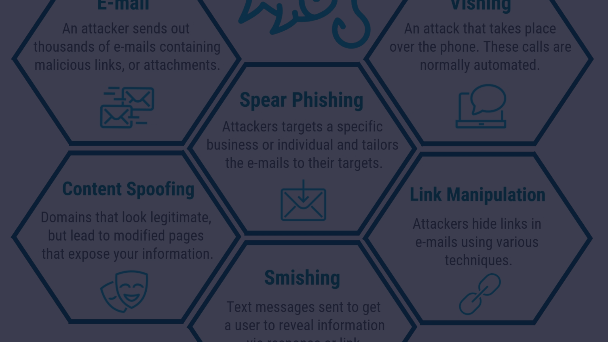
Understanding Phishing Tactics
1
Spoofed Emails
2
Fake Websites
3
Social Engineering
Phishers often send emails that appear to be from legitimate organizations, like banks or tech companies, in an attempt to steal your information.
Phishing websites are designed to mimic real websites in order to trick you into entering your login credentials or other sensitive data.
Attackers may try to manipulate you through phone calls, text messages, or in-person interactions to gain your trust and extract information.

Slide 3
Recognizing Phishing Emails
Red Flags
Sender Details
Suspicious Links
Be wary of emails with urgent language, generic greetings, or requests for personal information.
Check the email address - does it match the organization it claims to be from? Look for slight misspellings or differences.
Hover over any links to see the actual URL before clicking. Phishing links often have subtle variations from the real domain.

Slide 4
Identifying Phishing Websites
URL Inspection
Security Indicators
Look for misspellings, extra characters, or suspicious domains that don't match the brand they're imitating.
Check for a valid SSL/TLS certificate and the "https://" prefix, which indicate a secure website.
Unusual Content
Trust Your Instincts
Be wary of websites with poor design, broken links, or requests for information that seem out of place.
If a website feels off or suspicious, it's better to err on the side of caution and avoid it.

Slide 5



Protecting Against Social Engineering
Question
Refuse
Report
Always verify the identity of the person contacting you, even if they claim to be from a reputable organization.
Don't provide any sensitive information or follow instructions from an unverified source.
If you suspect a social engineering attempt, report it to the appropriate authorities or security team.

Slide 6

Best Practices for Avoiding Phishing
1
Stay Vigilant
Be cautious of unsolicited messages and carefully inspect any links or attachments before interacting with them.
2
Verify Legitimacy
Contact the organization directly through a known, trusted channel to confirm the request is legitimate.
3
Use Strong Security
Maintain up-to-date antivirus and anti-malware software, and enable two-factor authentication on your accounts.

Slide 7
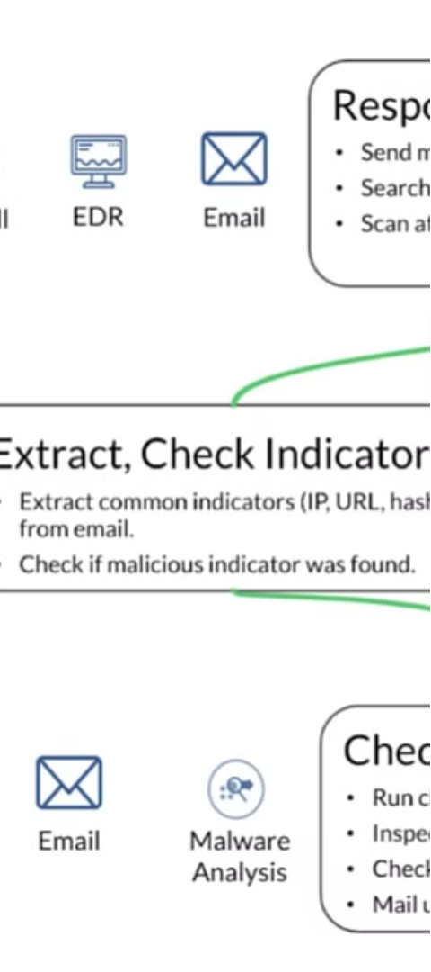



Reporting and Responding to Phishing
Identify
Recognize the phishing attempt and do not respond or engage with the attacker.
Document
Gather and preserve any evidence, such as screenshots or email headers, that could aid in the investigation.
Report
Notify the appropriate authorities, your organization's security team, and the targeted company or brand.

Slide 8
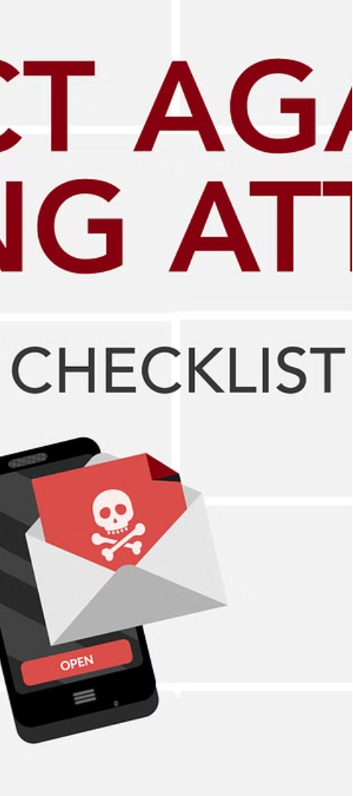
Conclusion and Key Takeaways
1
Phishing Threats
2
Vigilance is Key
Phishing attacks can have serious consequences, including identity theft, financial loss, and network compromise.
Stay alert, verify the legitimacy of any suspicious requests, and use strong security measures to protect yourself.
3
Reporting Matters
Reporting phishing incidents helps authorities and organizations combat these threats and protect others.

